Slide 1
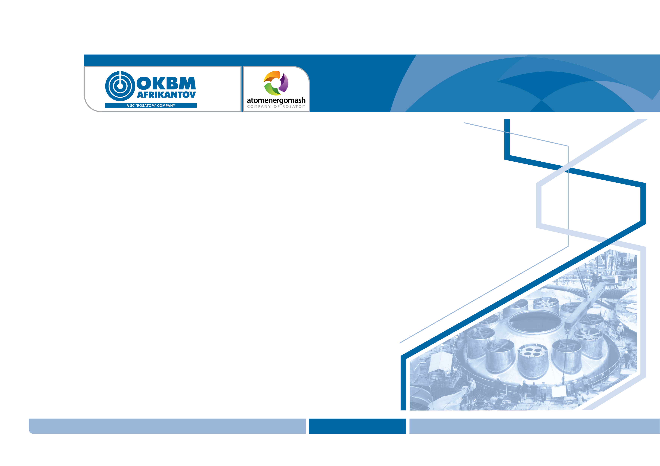
The 11th Conference on Reactor Materials Science at JSC SSC RIAR
May 27–31, 2019
Status and Development Areas of Reactor Cores for Icebreaker Nuclear Propulsion Plants and Small-Sized NPPs
Authors: V.V. Petrunin, A.I. Romanov, V.Yu. Papotin,
A.N. Lepekhin, A.A. Zakharychev, S.G. Petrov
JSC “Afrikantov OKBM”, Nizhny Novgorod, Russia

Slide 2

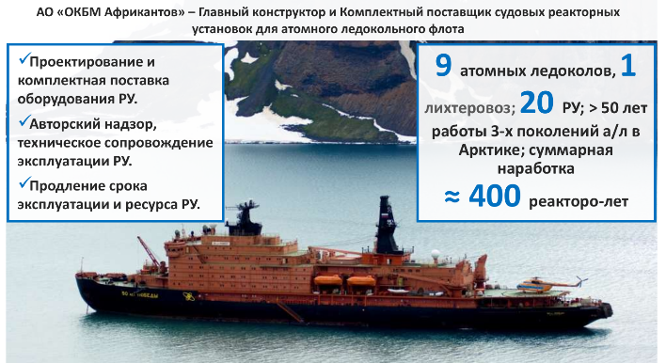
Reactor Plants for Nuclear-Powered Civil Ships (since 1954)
JSC “Afrikantov OKBM” is the Chief Designer and Complete Supplier of marine reactor plants for the nuclear icebreaker fleet.
Designing and complete delivery of reactor plant equipment
Field supervision, maintenance of reactor plant equipment
Extending the reactor plant lifetime and service life
9 nuclear icebreakers; 1 LASH carrier;
20 reactor plants;
> 50 years of operation for 3 generations of nuclear icebreakers in the Arctic Region;
the total operating time is
≈ 400 reactor years

Slide 3
Reactor Core 14-10-3
DESCRIPTION | 14-10-3М 14-10-3MP | 14-10-3U
Stored energy, TW⋅h | 2.1 | 2.7
Design lifetime, h | 34,000 | 40,000
Number of FAs: | 241
Circumscribed diameter, mm | 1212
Core height, mm | 920
²³⁵U load, kg | 170.4 | 218.7
Specific consumption of ²³⁵U, g/MW⋅day | 1.95 | 1.94
Maximum burnup, g/cm³ | 1.14 | 1.41
3

Slide 4
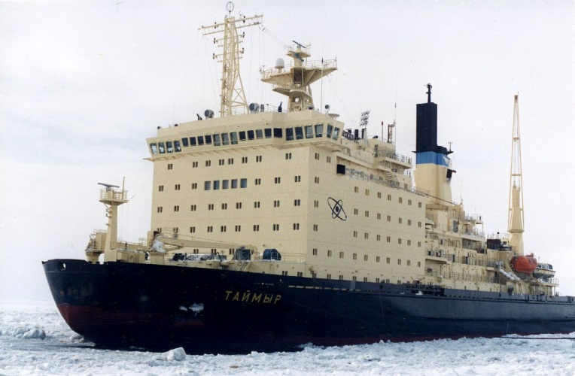
Pilot Core 14-10-3U
Enhancing the lifetime characteristics of the elemental base
The important task is to study spent fuel assemblies from the 14-10-3U core of the nuclear-powered icebreaker Taymyr.
Exceeded design stored energy
According to the evaluations made based upon the operating data, the stored energy with the CCG fully withdrawn will be 2.85 TW·h
Unique fuel rod burnup
At the 2.85 TW·h of generated energy, the burnup will be 1.47 g/cm³
E635
2.74
TW·h
1.42
g/cm³
4

Slide 5
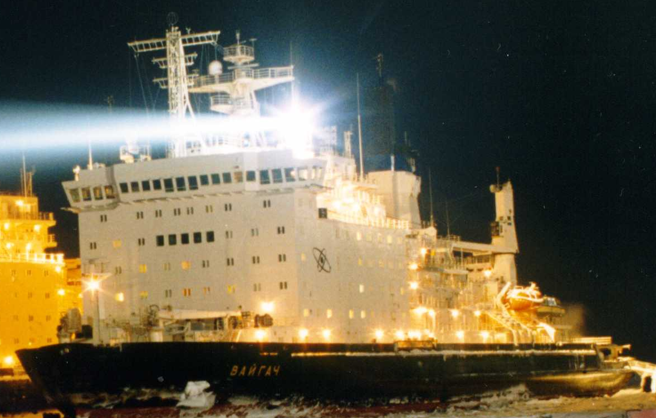
Pilot Core 14-5/04U
Verifying the lifetime reliability of the elemental base
With exceeded design value
The pilot core became a basis for the unique reactor core 14-5/04UM
42CrNiMo
2.31 TW·h
Basis
5

Slide 6
Pilot Core 14-5/04UM
Enhancing the lifetime characteristics of the elemental base
With exceeded design value
Unique fuel rod burnup
42CrNiMo
3.004 TW·h
1.13
g/cm³
6

Slide 7
Development of the 14-5/04UM Cores
Increasing the design stored energy starting from the second set (by 0.2 TW·h with limitations; and by 0.16 TW·h without limitations)
Increasing the design stored energy starting from the 4th–5th set by 0.25 TW·h without limitations
Increasing the design stored energy starting from the 4th–5th set by 0.25 TW·h without limitations
3.16 TW·h
3.25 TW·h
>1.13 g/cm³
7

Slide 8
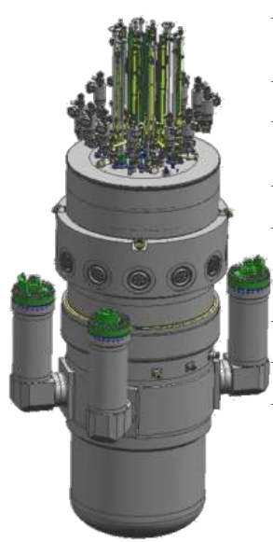
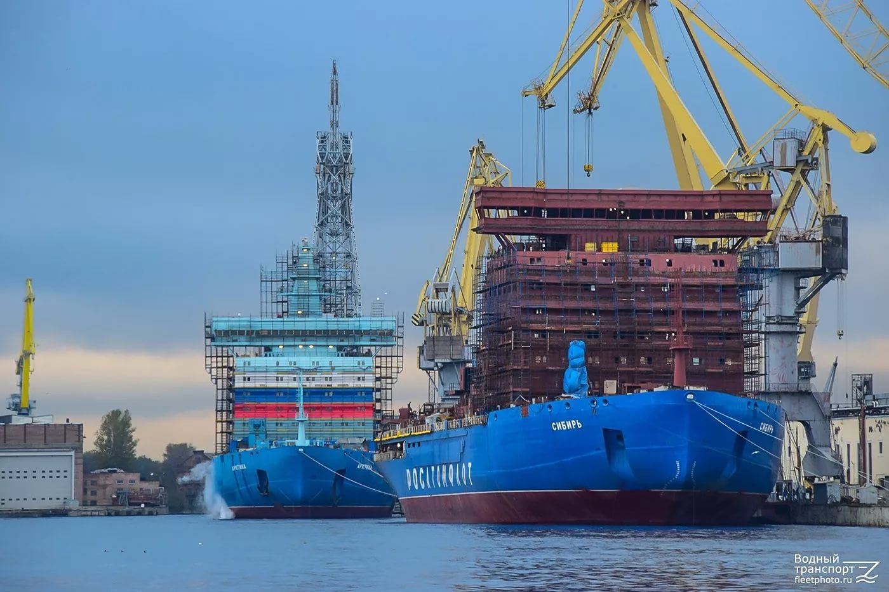
14-15-1 Reactor Core for RITM-200
Rated power
Assigned stored energy
Operating time at the service life of 12 years
175 MW
4.5
TW·h
75,000 h
8

Slide 9
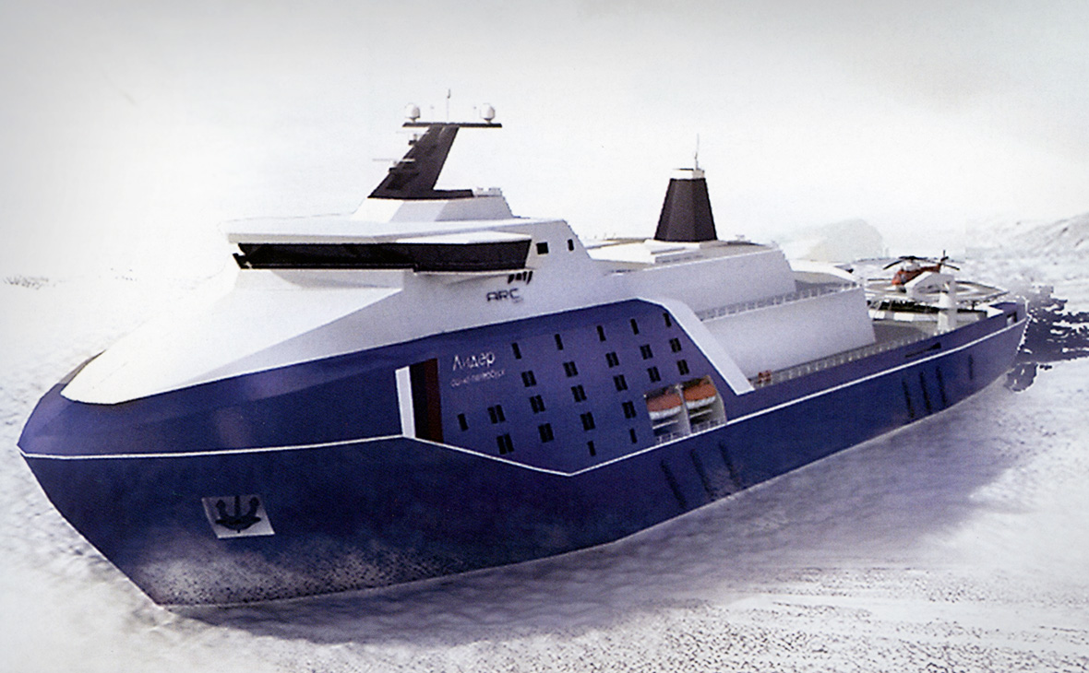
Reactor Core for RITM-400
Rated power
Assigned stored energy
Operating time at the service life of 10 years
315 MW
6.0
TW·h
60,000 h
9

Slide 10
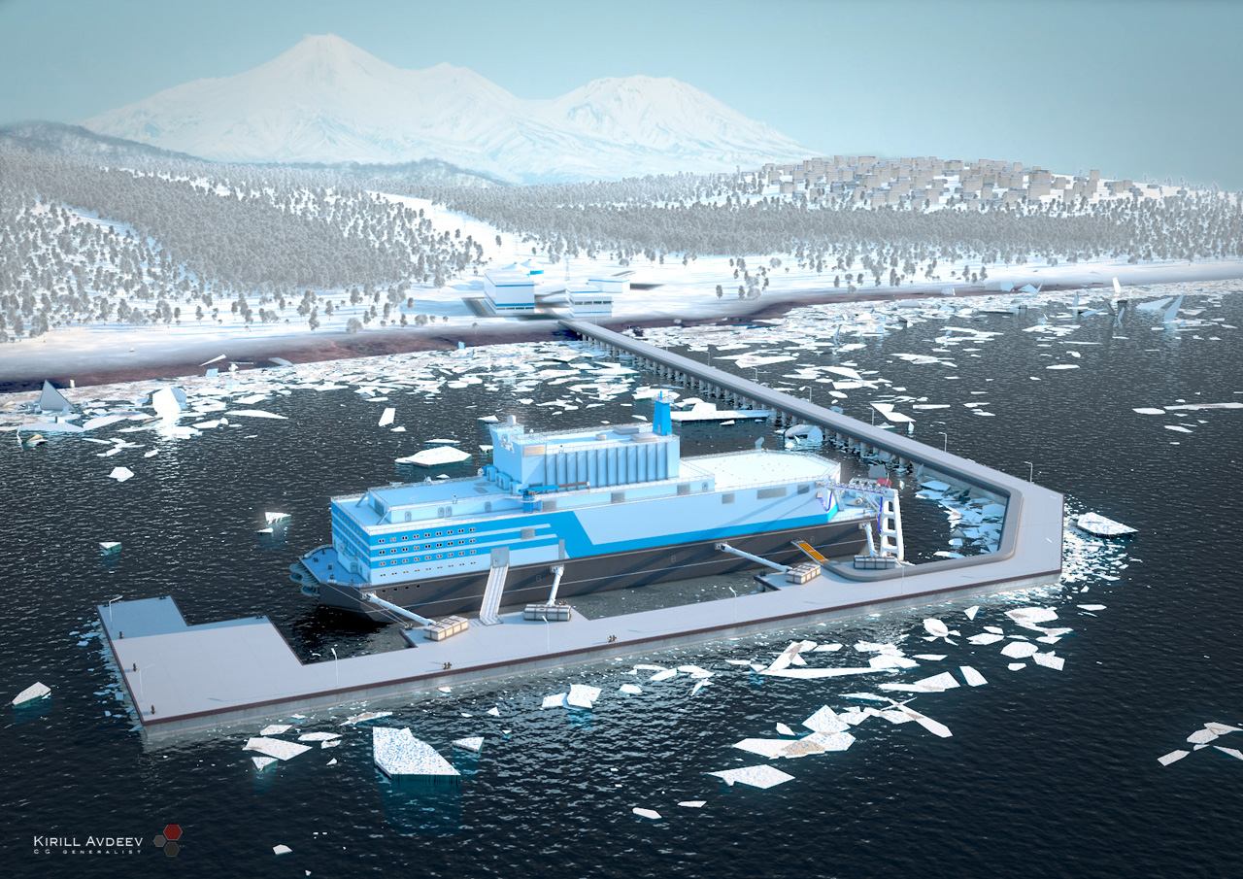
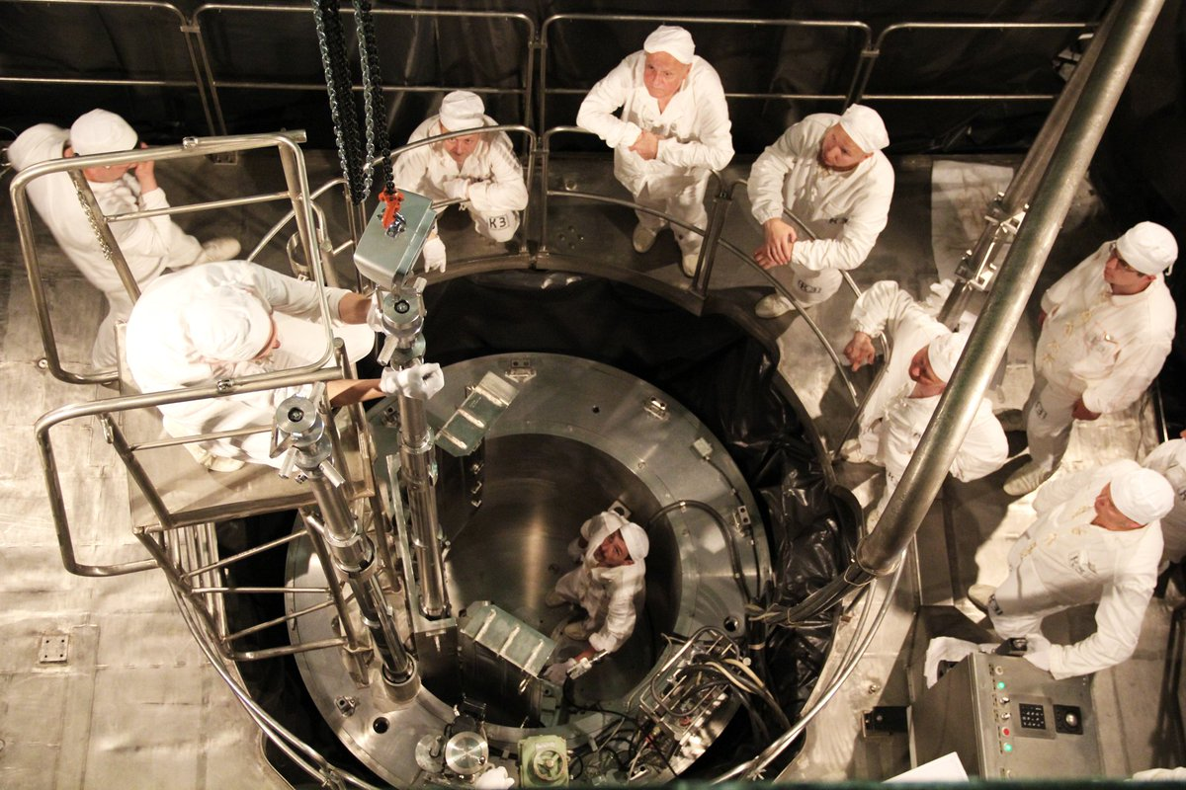
Development of the 14-14 Cores for Floating Power Units (FPUs)
The 14-14 core has been fuelled.
The first criticality has been achieved and first power has been generated.
Transportation to Pevek city is underway.
Completion date: August—September 2019
Developing a reactor core with increased stored energy (form the baseline 2.1 TW·h) underway
14-14
Development of the 14-5/04UM Cores
Pevek
3.1
TW·h
10

Slide 11
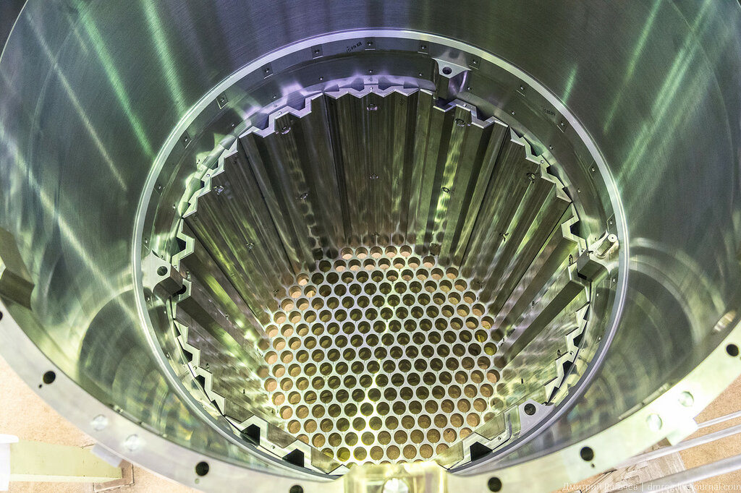
Reactor Core for Small-Sized land-based Nuclear Power Plants
Rated power
Assigned stored energy
Assigned cycle of operation
Refueling interval: 6–7 years
165–175
MW
8.0
TW·h
48,500 h
11

Slide 12
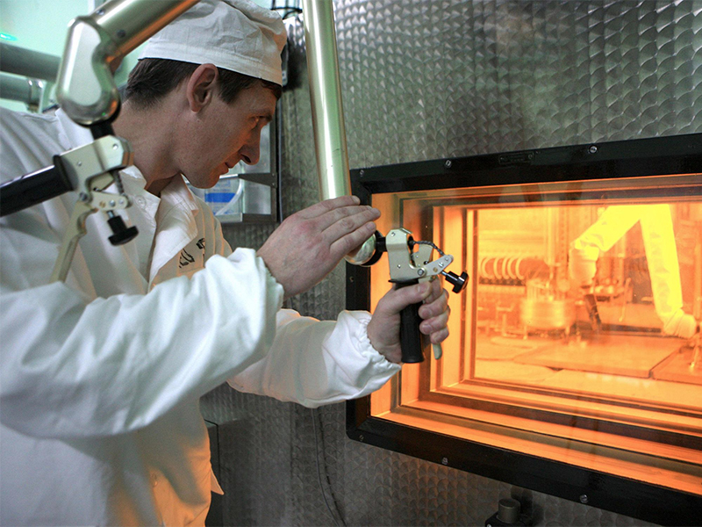
Small-Sized NPP Reactor Core Development.
Irradiation testing in the MIR reactor
Conduct studies on fuel rods from PTVS-31M loop fuel assembly (not covered by studies) under accident conditions.
In the MIR reactor, irradiation testing of the new loop fuel assembly with fuel rods of various designs.
In the MIR reactor, irradiation testing of short fuel rods of various designs in the GIRLYANDA (garland) irradiation device.
PTVS
31M
PTVS
Or
GIRLYANDA
12

Slide 13
Reactor Core for the Optimized Floating Power Unit
Rated power
Assigned stored energy
Assigned cycle of operation
Refueling interval: 10 years
38.5 MW
11.0 TW·h
57,000 h
13

Slide 14
Thank you for your attention!
14

