Slide 1
STUDY OF STANDARD FUEL ROD CLADDING OF THE PWR-TYPE REACTOR WITH PROTECTIVE COATING UNDER CONDITIONS TYPICAL OF A LOSS-OF-COOLANT ACCIDENT
FEDERAL STATE UNITARIAN ENTERPRISE “SCIENTIFIC RESEARCH INSTITUTE SCIENTIFIC INDUSTRIAL ASSOCIATION “LUCH”
(FSUE “SRI SIA “LUCH”)
STATE ATOMIC ENERGY CORPORATION "ROSATOM"
ХI reactor science conference
A.A. Urusov, A.A. Mokrushin, D.M. Soldatkin, K.K. Polunin
2019

Slide 2
INTRODUCTION
Safety is one of the main tasks in the design and operation of nuclear power plants. Justification of NPP safety includes an analysis of the development of design and beyond design basis accidents, which can lead to depressurization of fuel rods, severe damage, core melting, hydrogen release and radioactive fission products.
Although existing reactors and even more so the latest generation of reactors provide multi-level, echeloned protection from such a scenario, events in Japan have shown that with a certain, very rare combination of adverse circumstances, this is possible.
In this regard, work has been intensified to create a fundamentally new fuel that can withstand the conditions of severe accidents while maintaining or improving economic performance and safety during normal operation. Many developments of this kind have received the collective name Accident Tolerant Fuel (ATF) - a fuel with increased resistance to accidents. In the formulation of the IAEA, this fuel should be efficient both under normal operating conditions and, most importantly, under conditions of loss of coolant.

Slide 3
Tolerant fuel
Problems and tasks of ATF fuel
Slow down the release of free hydrogen
Improve the thermal-mechanical properties of the cladding and the fuel
Improve the fuel economic features, including post-reactor cycle performance
Improve the kinetics of the cladding reaction with steam
Reduce the yield of fission products
Ways to solve the problem
Development of protective coatings for zirconium cladding
Replacement of zirconium core elements
Complete replacement of zirconium cladding
Creating a new type of fuel
U₃-Si₂
U-N
U-Zr
U-Mo
UO₂-Cr₂-O₃-SiC
Dispersion fuel
Fe-Cr-Al
SiC-SiC
Mo
Thin-walled steel shells
Nb₂-Al-C
Zr-Si₂
Ti₂-Al-C
MAX-фазы
Cr
Fe-Cr-Al
SiC-SiC

Slide 4
High temperature protective coating
Requirements for the protective coating of the cladding
Manufacturability (process automation)
High corrosion resistance over a wide temperature range
Min absorption cross-section of slow neutrons
Phase stability at high temperatures
Linear thermal expansion coefficient of the coating close to the LTE coefficient of the cladding
Radiation resistance
High thermal conductivity
High adhesion to the matrix
The choice of chromium as a protective coating material is due to its:
High melting point
Tm - 1890 ° C
Exceptionally high corrosion resistance in water, steam and air
Low cross-section capture of thermal neutrons (σа = 3.05 × 10⁻²⁸ m²).
High mechanical and technological properties
CLTE αL - 4.9 × 10⁻⁶ К
Thermal conductivity λ = 93.9 W / (m • K)

Slide 5
Materials and methods
Samples of sponge-based E110 alloy, cut from standard cladding of PWR-1000 fuel rods (Ø 9.10 7.93 mm), L - 10 mm, were prepared.
The gas-dynamic modification of the sample surface with chromium powder (particle size of 50–200 µm) was carried out during 90 seconds.
A protective chrome plating was applied by an electrochemical method by immersing fragments of zirconium cladding into a solution of chromic anhydride.
Bilateral oxidation of the cladding samples was carried out at the GAZPAR test facility. Oxidation at a temperature of 1200°C during 500 seconds is a regime bordering on reaching the critical mechanical state of the cladding (residual ductility below 2%). Thus, of interest are tests at a temperature of 1200°C and an oxidation time 2–3 times higher than the embrittlement threshold (1000–1500 sec).
The analysis of the state of the surface and the structure of the samples was carried out with the help of optical and electron microscopes. Measurement of the roughness of the sample coating was performed using a MarSurf M400 profilometer. The residual plasticity of the cladding was determined by the method of diametrical compression of the ring samples on a Zwick Z100 testing machine at a temperature of 135°C.

Slide 6
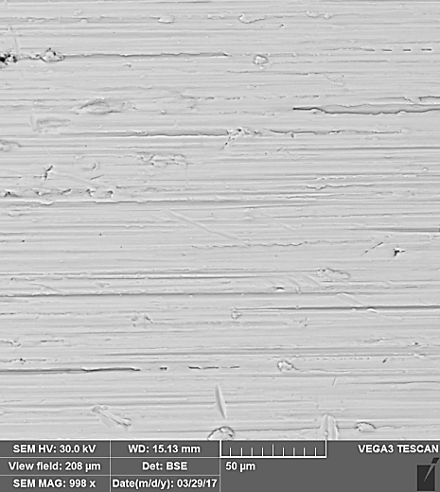
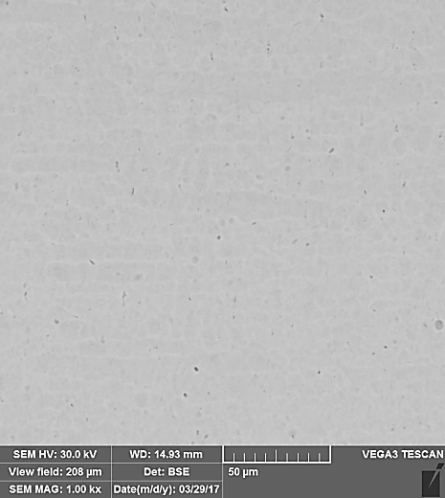
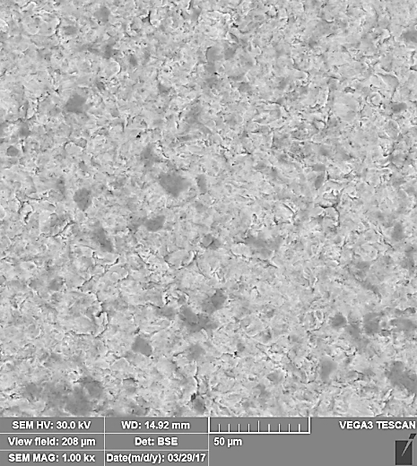
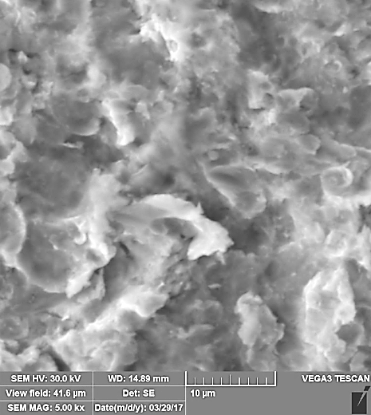
Preparation and coating
Original sample
Etching
Gas dynamic treatment
X-Ray Spectroscopic Analysis of the Surface Condition
Determination of the surface roughness
•1
•3
•5
Point | O % | Cr % | Zr % | Amount %
1 | 6.77 | 10.51 | 82.73 | 100.00
2 | 3.63 | 0.34 | 96.03 | 100.00
3 | 2.90 | 0.26 | 96.83 | 100.00
4 | 3.45 | 0.56 | 95.99 | 100.00
5 | 4.54 | 0.63 | 94.82 | 100.00
•4
•2
<R_{a}> = 0,50 ± 0,06 μm

Slide 7
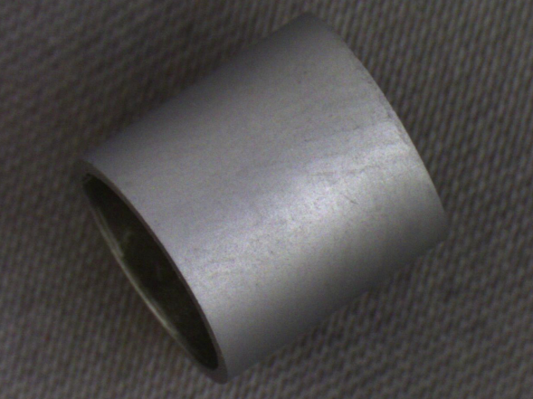
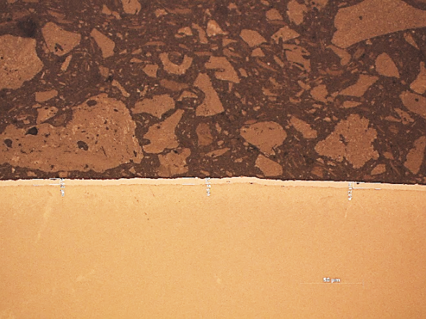
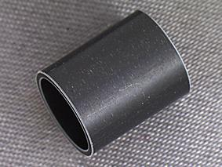
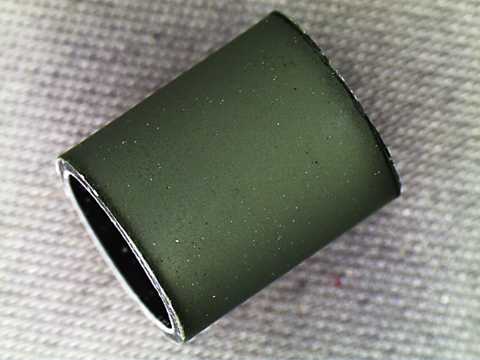
Corrosion testing
Cladding samples with coating thickness from 2 to 20 μm were obtained by electrochemical method
Zr
Cr
Figure 1. The appearance of the cladding
Figure 2. Cross section, thin section
High-temperature corrosion tests (T-1200°C)
Figure 3. The appearance of the cladding after oxidation without coating
Figure 4. Dependence of the specific mass change of the cladding sample on the time of oxidation in water vapor at a temperature of 1200°C
Figure 5. The appearance of the cladding after oxidation with the coating

Slide 8
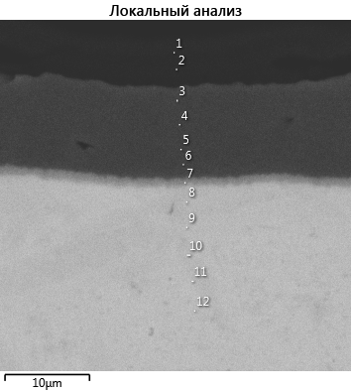
Material studies
Cr₂O₃
Cr
α-ZrCr2
«ex-β»-layer
Zr
α-Zr(O)
ZrO₂
Figure 6. Cross-section of a coated sample after corrosion testing
Zr
Cr
The formation on the outer surface of a layer of chromium oxide (Cr₂O₃), ~ 30% of the coating thickness.
The interdiffusion of the elements of the zirconium cladding and the chrome plating with the formation of the α-ZrCr2 phase is noted.
O
Figure 7. The results of the distribution of the elements of the cladding on the external border obtained by the method of x-ray spectral analysis

Slide 9
Results
Comparison of the thickness of the inner layers of cladding with and without coating after high-temperature oxidation
Sample | Thickness, µm |  |  |  |  |  | Specific weight change, mg / cm2 | Residual plasticity δ
 | ZrO₂ external | Coating | α-Zr(O) external | “ex-β”-layer | α-Zr(O) interior | ZrO₂ interior
Duration 1000 s
No coating | 84 | – | 98 | 256 | 107 | 75 | 16,9 | δ˂2%
Coated | – | 5 | – | 395 | 112 | 75 | 9,1 | δ˃2%
Duration 1500 s
No coating | 152 | – | 124 | 122 | 116 | 168 | 22,9 | δ˂2%
Coated | – | 5 | – | 377 | 56 | 180 | 12,2 | δ˃2%
Outer surface of
the cladding
line corresponding to the maximum oxygen content (0.7 weight %) in the “ex-β” - layer
Inner cladding surface
Thickness δ,μm

Slide 10
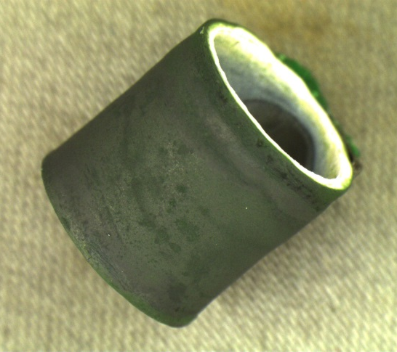
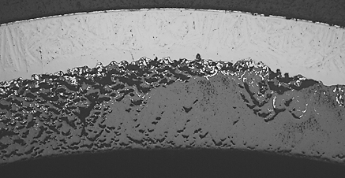
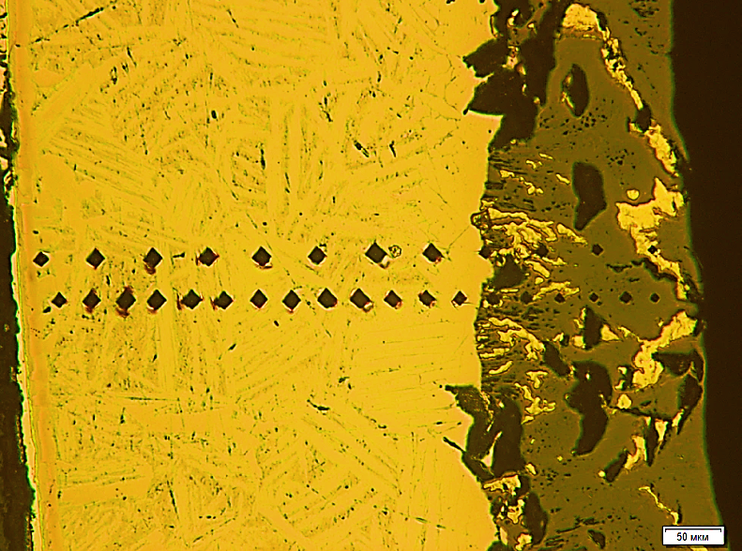
Corrosion tests in steam-air mixture 1350°C
Appearance
Sample microstructure
190 μm
«ex-β»-layer
ZrN
6 μm
Cr₂O₃
15 μm
Cr
20 μm
α-ZrCr₂
370 μm
«ex-β»-layer
α-Zr(O)
150 μm
170 μm
Outer surface of
the cladding
Inner cladding surface
ZrO₂
ZrN
«ex-β»-layer
α-Zr(O)
α-Zr(O)

Slide 11
Findings
In this paper, the effect of chromium coating on the corrosion resistance of fuel cladding made from sponge-based E110 alloy was studied when tested in water vapor at a temperature of 1200°C.
The surface of the cladding was studied with scanning electron microscopy. It has been shown that a positive effect in the adhesion of the protective coating to the surface of the cladding is achieved by gas-dynamic treatment with the uniform introduction of chromium particles into the surface layer.
The experiments on the application of protective coatings with a thickness of up to 20 μm to the external surface of the fuel element cladding by the electrochemical method were performed. It has been shown that the coating thickness does not affect the final value of the surface roughness of the cladding.
Tests were carried out on the bilateral oxidation of cladding samples with a protective coating in a water vapor on a GAZPAR test bench. It has been discovered that for samples with a coating thickness of 12 μm, oxidized at a temperature of 1200°C, a decrease in the specific mass change is observed. An increase in the thickness of the “ex-β” layer, due to the absence of the α-Zr (O) phase on the coating side, contributes to maintaining the residual plasticity above 2%.
Steam-air tests at 1350 ° C showed high-temperature corrosion resistance of the chrome coating.

Slide 12
THANKS FOR ATTENTION!

